Slide 1
Workshops for Ukraine Introducing Power Bpy a python package for creating Power BI dashboards May 22nd, 2025 Russell Shean

Slide 2
Outline
What is this workshop series?
Who am I?
Building dashboards with Power BI
What is Power BI?
My old job
A history of Power BI file structures
Implications of new file structures

Slide 3
Outline
Demonstration: create a new power BI dashboard with python
How it works
Theory and development process
Existing functions
Create new dashboard
Load data
TMDL
Local csv
csv on ADLS
Add new page
Add shape map

Slide 4
Outline
Development setup (GitHub, documentation, PyPI, etc)
How you can help!

Slide 5
Workshops for Ukraine
What is this workshop series?
Series of technical workshops
Why is it important?
Upskill!
Support Ukraine

Slide 6
About Me
Freelance data scientist/data engineer
Background in public health
Rhode Island Department of Health
Washington State Department of Health
Taipei based

Slide 7
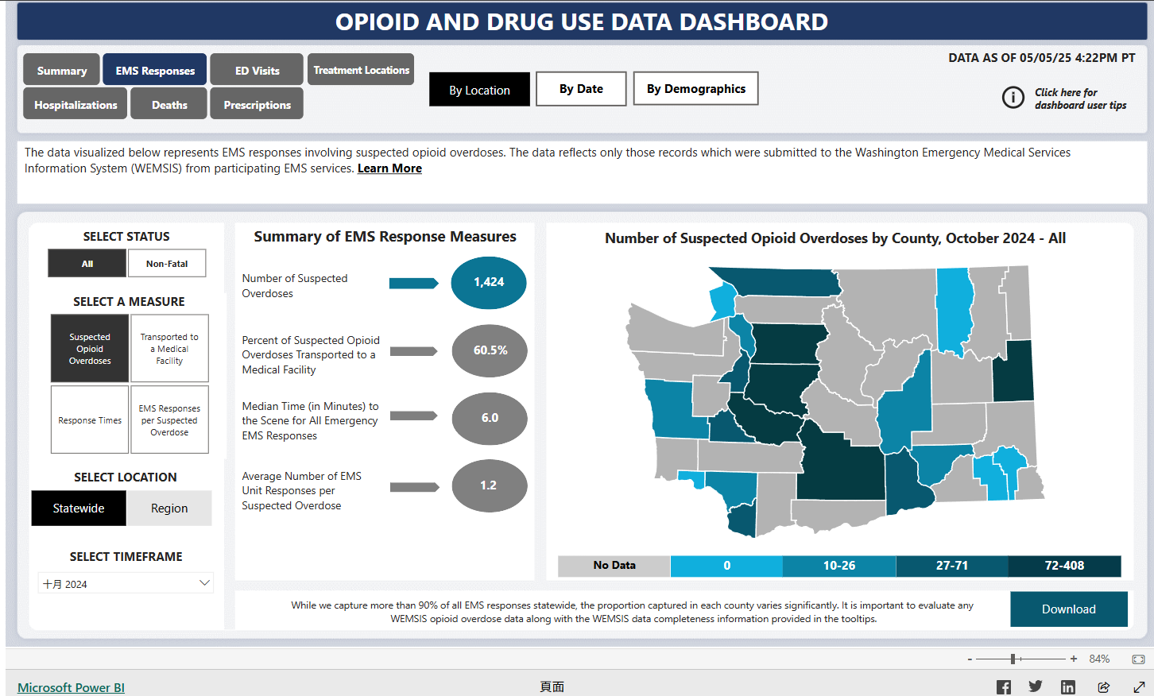
Dashboards at WADOH
The visualization section builds a variety of dashboards
Data cleaning and aggregation in R
Dashboards in Power BI

Slide 8
My job at WADOH
At start: Data processing pipelines in R
Later: Automation, cloud transition, process improvement
R pipelines are already fairly automated and optimized
How can we speed up Power BI process too?

Slide 9
What is Power BI?
Microsoft product for building dashboards and business intelligence
Data processing, modeling and visualization
Included with many organizations’ Microsoft subscriptions
Ties into other Microsoft products such as Fabric
Low/no code tool

Slide 10
Power BI Advantages
Bundled with existing Microsoft product subscriptions
Supported publishing
Existing style guide, trained staff and workflows
Low/no code

Slide 11
Power BI Challenges
Low/no code
No version control
Not reproducible
Difficult to use data processing
Difficult to automate

Slide 12
How to make Power BI dashboards
Normal way: Power BI desktop
Pause slides for live tour of Power BI desktop

Slide 13
Power BI file structure: A history
First iteration: .pbix
A binary file
Similar to .zip file, multiple files inside
Possible to extract internal files and make changes
Difficult to put back together
Security bindings file
Pause slides: for live demo of extraction

Slide 14
Power BI file structure: A history
Second iteration: .pbip
Report and data specifications stored as plain text
Mostly json
Better, but not ideal for version control
Pause slides for demonstration

Slide 15
Power BI file structure: A history
Final iteration: .pbir
Unnested json
TMDL: new format for specifying data
Sort of yaml-like….(ish)
Pause for demo

Slide 16
Power BI file structure: A history
Data format: Tabular Model Definition Language (TMDL)
Human-readable, version-controllable, separate files for different objects
https://learn.microsoft.com/en-us/analysis-services/tmdl/tmdl-overview?view=asallproducts-allversions
https://powerbi.microsoft.com/zh-tw/blog/tmdl-in-power-bi-desktop-developer-mode-preview/
Pause for demo

Slide 17
What we have so far
No python yet… sorry 😅
Visual elements are defined in individual folders and files for each page and visual object
Visual elements are defined with json
Data has 2 parts
Column definitions
M code used for loading and processing
Throughout: machine generated unique UUID
No name conflicts, but super not human readable

Slide 18
What does this mean?
Thing 1: Text files can be edited directly without opening Power BI Desktop --- Great for quick fixes
Thing 2: Changes to dashboards can easily be tracked in Git diffs
Thing 3: Theoretically, you could write python functions to create and modify dashboards!!!!
Treat json as dictionaries
String manipulation for TMDL, M code and file structure

Slide 19
Queue the Python!….Finally😅
I’m assuming you already have python installed
To install package:
py -m pip install powerbpy
Test file (may need to change data locations): https://github.com/Russell-Shean/powerbpy/blob/main/examples/create_example_dashboard.py
Pause for demonstration of dashboard creation script

Slide 20
How does it work?
Individual functions for adding different types of datasets
Individual functions for each visual element
Some visual elements are more complicated and call other functions from the package
e.g. the map uses the functions for adding text boxes and slicers
the new page function adds a text box
User supplied ids instead of machine generated UUID
Pause to show file structure

Slide 21
Development process
Step 1: commit dashboard to git
Step 2: make change in Power BI Desktop
Step 3: commit change to git
Step 4: Use diff to figure out how to reverse engineer changes and create python function
Pause for demo

Slide 22

Power Bpy
Collection of functions to create elements of Power BI dashboards
Pypi: https://pypi.org/project/powerbpy/
Github:https://github.com/Russell-Shean/powerbpy
Website: https://www.russellshean.com/powerbpy/

Slide 23
Create new dashboard
Function has to create multiple new files
Default files copied from dashboard_resources folder inside PyPI package
from importlib import resources
traversable = resources.files("powerbpy.dashboard_resources")
with resources.as_file(traversable) as path:
shutil.copytree(path, project_folder_path)
Files are modified to add report name and unique UUID to template
Pause for demo

Slide 24
Repeated pattern
Load json as a dictionary
Modify key-value pairs in the dictionary with user provided arguments
Write out the modified dictionary as json

Slide 25
Load data
Trickier because not specified using json
Uses TMDL and M code
For example: csv
Load csv as pandas dataframe
Loop through columns and write out specifications as TMDL
Reverse engineer and write out M code to load data in Power BI
Central assumption: You want to do data prep in python not power BI
Power Bpy functions very picky about format
It’s easier to write python cleaning scripts than reverse engineer M code for edge cases

Slide 26
Load data
Limited supported types
Again, easier to prep data and change format in python
Local csv, azure blob storage csv, TMDL file

Slide 27
Load data: TMDL
Easiest
Already in the correct format so you can
Copy tmdl file to semanticmodel folder
Update diagramlayout (update_diagramLayout)
Update model (update_model_file)
Gotchya: sometimes the M code has hard-coded file paths to local files….
Pause for demo

Slide 28
Load data: local csv
More difficult
Need to
Load csv as dataframe
generate all TMDL code from dataframe
generate M code to load csv file
Update diagramlayout and model
Pause for demo

Slide 29
Load data: csv from ADLS
Azure Data Lake Storage (ADLS) is a cloud data storage system from Microsoft
Can directly link a power BI dashboard to an ADLS blob
Can update data in ADLS, Power BI will use new data automatically
Power Bpy Function:
Attempts login to ADLS
Reads data from ADLS into pandas
Creates TMDL and M code to establish ADLS Power BI link

Slide 30
ADLS login
3 options
Browser authentication (user provides tenant id)
SAS url (user provides SAS for time limited file-scoped access)
Storage account key
On local computer: user is prompted to provide key interactively and key is stored in windows credential manager
In cloud environment: user passes credential directly (presumably from the cloud provider’s secret manager NOT HARD-CODED)
Pause for demo of token storage

Slide 31
Add new page
add_new_page(dashboard_path, page_name, title = None, subtitle = None)
Creates a new folder for a new page, and new json for the page
User provides a human readable id (page_name)
User can provide a title and subtitle
Function calls add_text_box() function under the hood
Pause for demo

Slide 32
add_text_box
Example of json schema
Function arguments are passed into json
Json complexity can scale up and down
Optional arguments are added using key value pairs later
Example: background color
Pause to show code

Slide 33
add_shape_map
data_source: The name of the dataset you want to use to build the map.
shape_file_path: A path to a shapefile that you want to use to build the map.
location_var: The name of the column in data_source that you want to use for the location variable on the map
color_var: The name of the column in data_source that you want to use for the color variable on the map
filtering_var: Optional. The name of a column in data source that you want to use to filter the color variable on the map.

Slide 34
add_shape_map
color_palatte: A list of hex codes to use to color your data.
percentile_bin_breaks: This should be a list of percentiles between 0 and 1 that you want to us to create bins in your data. If provided, a filtering_var must also be provided. This will create power BI measures that dynamically update when the data is filtered by things such as slicers.

Slide 35
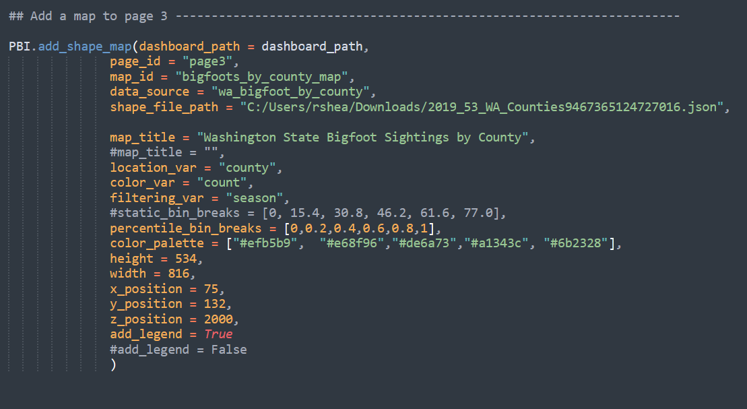

Slide 36
add_shape_map
Pause to show map
Multiple pieces:
Slicer to filter data by season
Legend that updates with filtered data
Choropleth map that updates with filtered data
Adds “measures” (essentially reactive functions) to the dataset
Pause to show code

Slide 37
Development setup
Code on GitHub
Documentation
quartodoc: https://machow.github.io/quartodoc/get-started/overview.html
Hosted on GitHub pages
GitHub actions:
Update documentation
Run (nonexistent) unit tests
Build and upload distributions to PyPI

Slide 38
Inspired?
How you can help:
Python pull requests
Complaints
No unit tests, no oop, bad code design etc
Power BI feature requests
No python needed!
Description of what you want
Best: GitHub diff showing what you want

Slide 39
Get in touch
Happy to chat about Power Bpy for free
Also looking for freelance clients
Data pipelines
Cloud devops (Azure, Databricks, Posit)
Automation
Visualizations (maps, shiny dashboards, etc)
Weird projects like this one
Contact info on next slide!

Slide 40

Contact
LinkedIn: https://www.linkedin.com/in/russell-shean/
GitHub: https://github.com/Russell-Shean
Email: russshean@gmail.com
Bluesky: http://rshean.bsky.social/

